Slide 1
Data preparation – Excel (HOBO)
Work through example using Excel and HOBOware

Slide 2
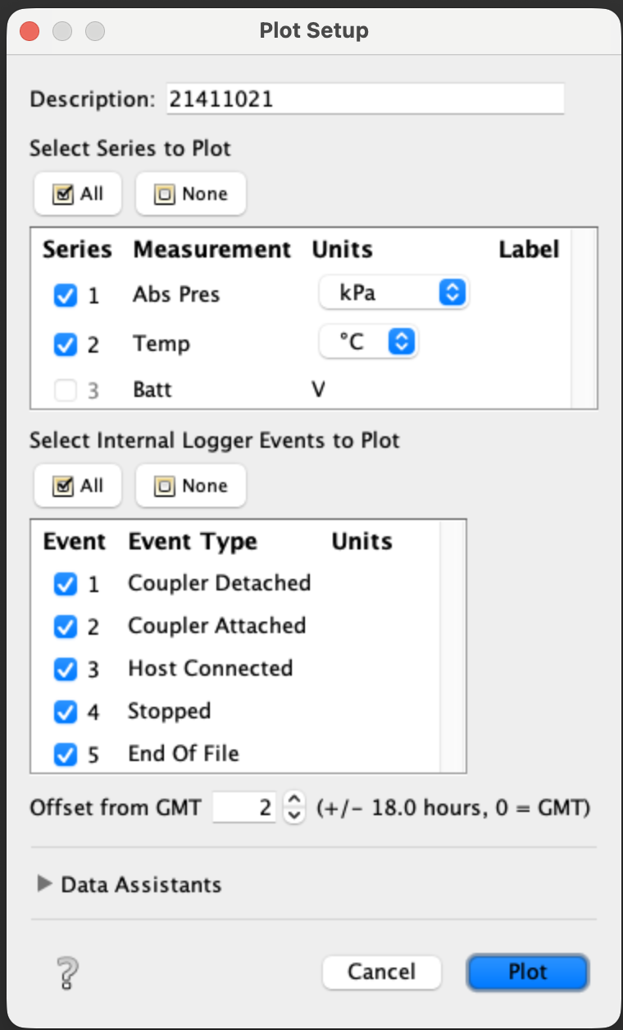
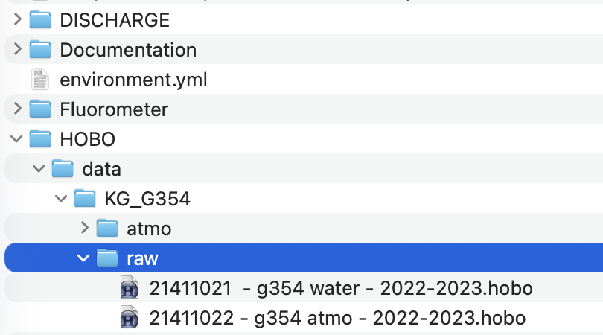
Original HOBO logger files
Open with HOBOware (timezone does not matter here)

Slide 3
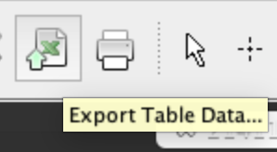
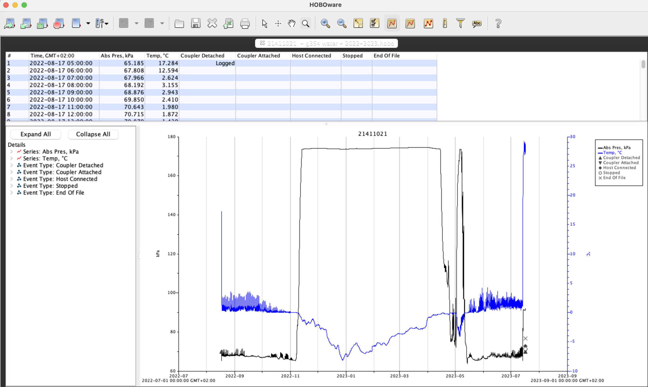

Slide 4
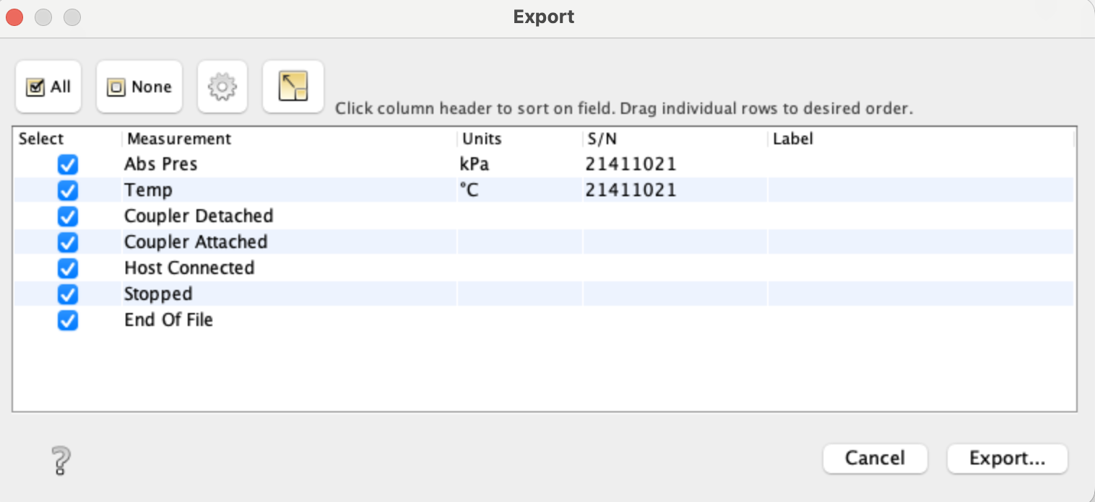
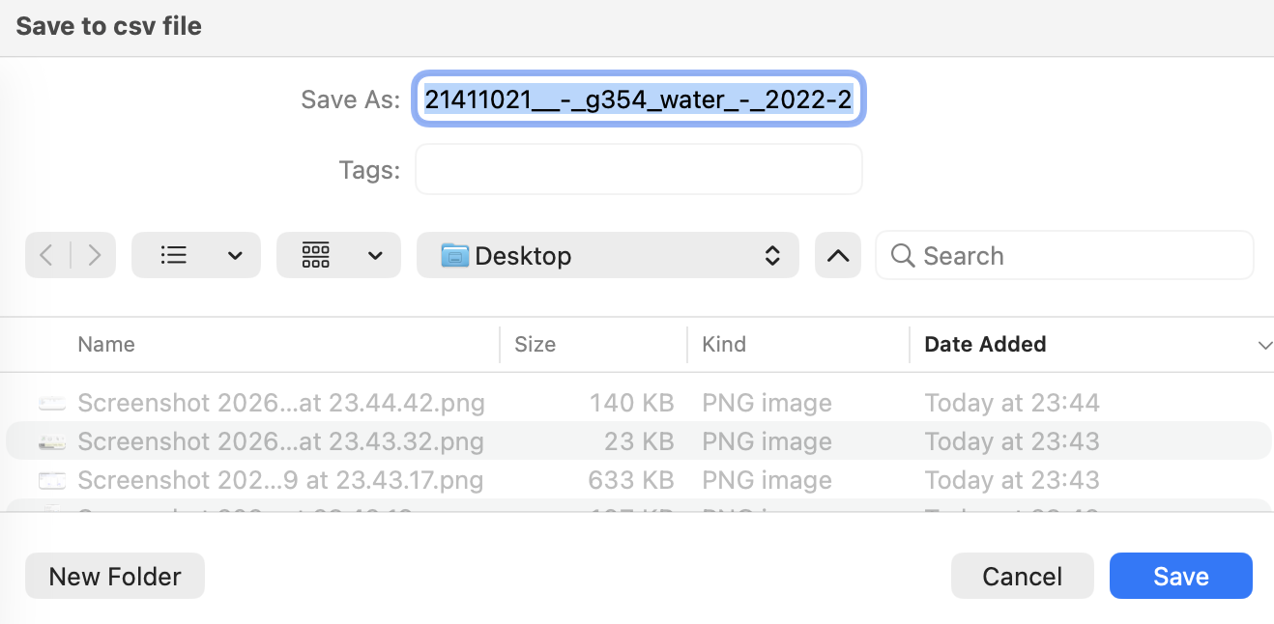
Export > Save (CSV format)

Slide 5

Open exported file in Excel

Slide 6

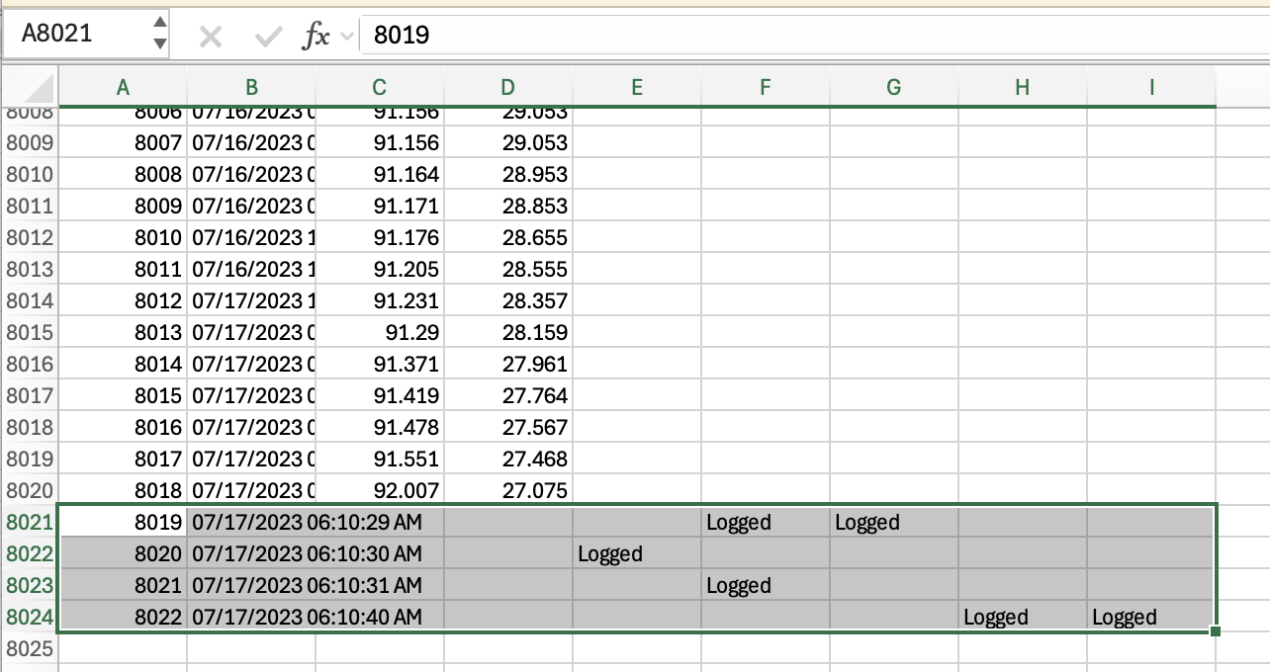
Useless information.
Delete all of these.

Slide 7

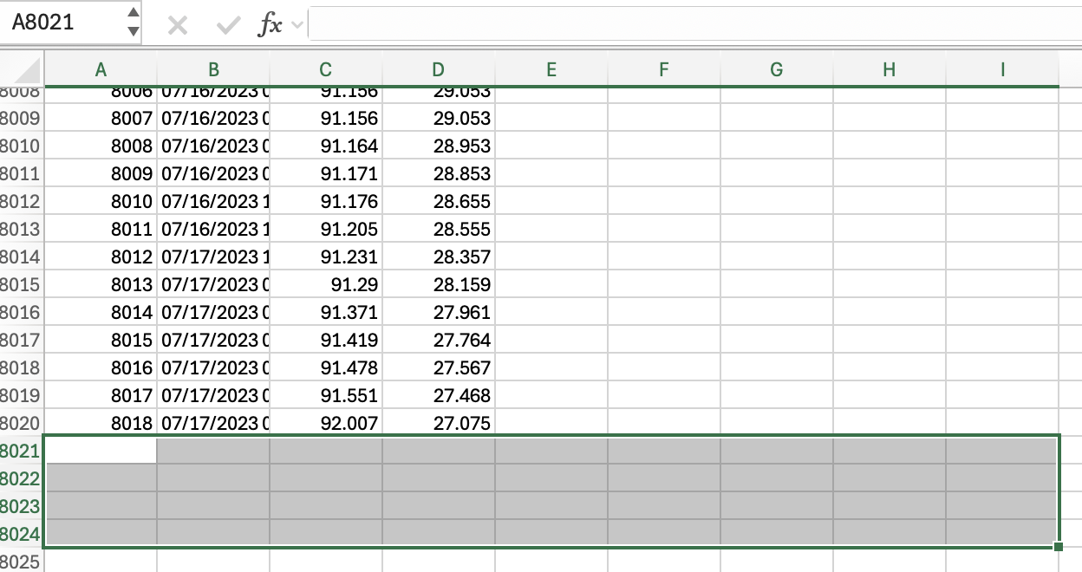
Useless information.
Delete all of these.

Slide 8
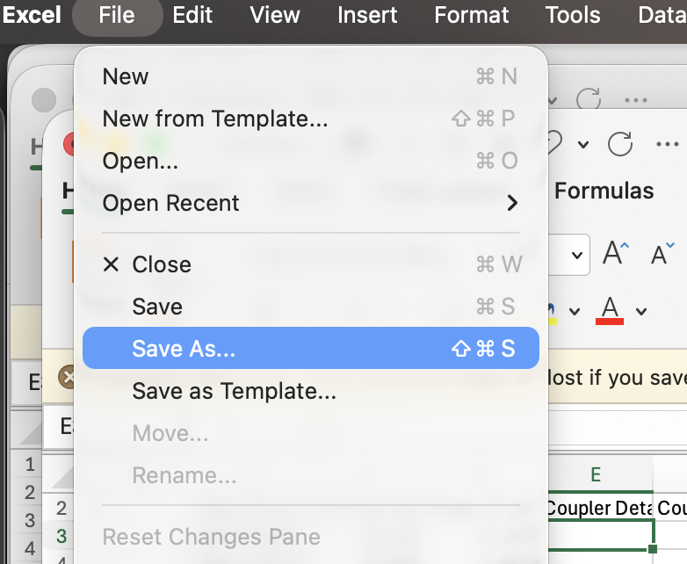
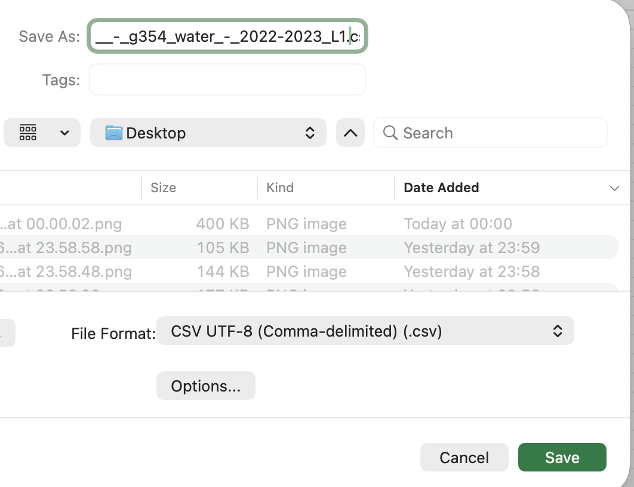
Save as L1
Repeat for all loggers (atmo + water)

